Slide 1
GMAPS
Collision Detection & Response

Slide 2
Part 3
Non-Axis-Aligned
Collision Response

Slide 3
Collision with a stationary object (non axis-aligned)
v_{final}
v_{initial}

Slide 4

Collision with a stationary object (non axis-aligned)
This requires some simple vector math
Find the perpendicular vector to the boundary, n (i.e. the normal vector).
Proj is projectionVec in the code below.
If the slope of the boundary is dy/dx, then the slope of n is -dx/dy.
v_{f}
n
Proj
2. Normalise n →
V
= n / |n|
-v_{i}
v_{i}
3. Find the projection (Proj) of -v_{i} onto
Proj = (-v_{i} ) *
float projectionLength = Vector2.Dot(-whiteBall.Velocity, wall.normalVec);
Vector2 projectionVec = projectionLength * wall.normalVec;

Slide 5
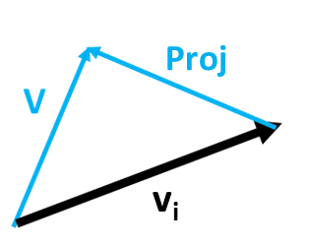
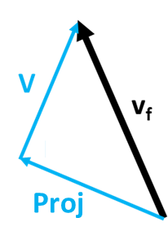
Collision with a stationary object (non axis-aligned)
2. V = v_{i} + Proj (by vector addition)
Remember, a vector has no position, so these V vectors are the same
V
v_{f}
Proj + V = v_{f}
Proj
V
v_{i}
Proj + v_{i} + Proj = v_{f}
2*Proj + v_{i} = v_{f}
Vector2 vf = (2*P) + whiteBall.Velocity;
whiteBall.Velocity = vf;

Slide 6
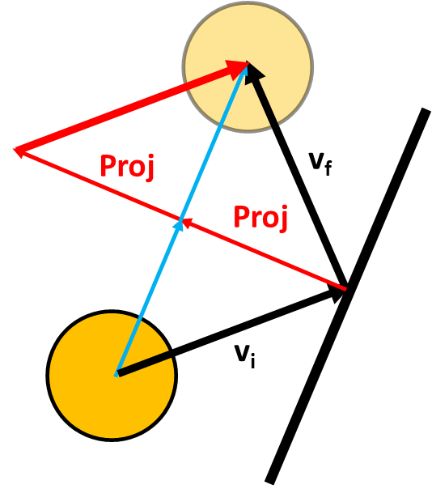
Collision with a stationary object (non axis-aligned)
A vector has no position, so both V_{i} vectors are the same
V_{i}
Visual explanation of
Vector2 vf = (2*P) + whiteBall.Velocity;
whiteBall.Velocity = vf; // velocity after collision
2*Proj + v_{i} = v_{f}
V_{f} is the final velocity of the ball after collision!

Slide 7
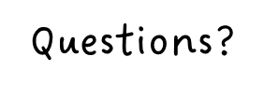

Slide 8
Now do Part 4 of GMAPS_Collisions_Worksheet.docx

